Slide 1
Screen planning

Slide 2
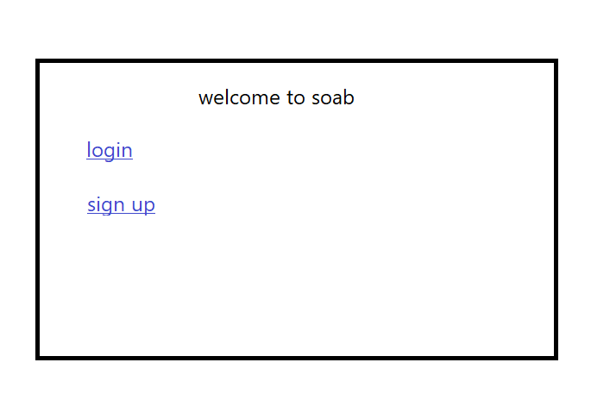
Opening

Slide 3
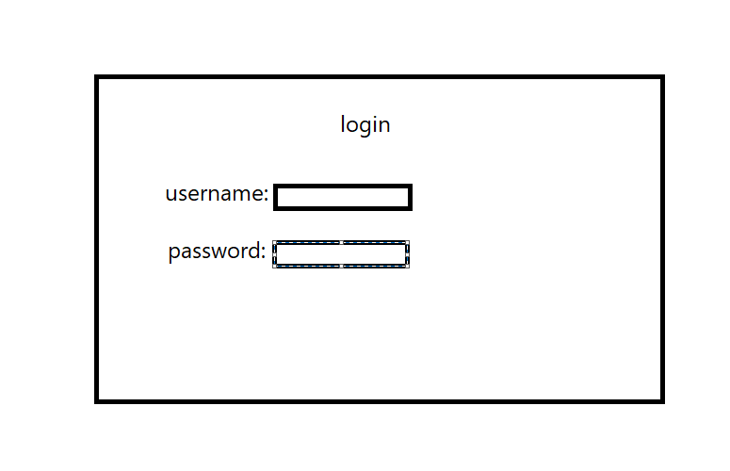
Login screen

Slide 4
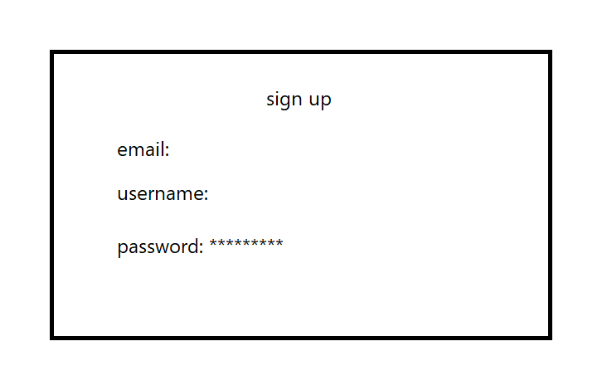
Signup screen

Slide 5
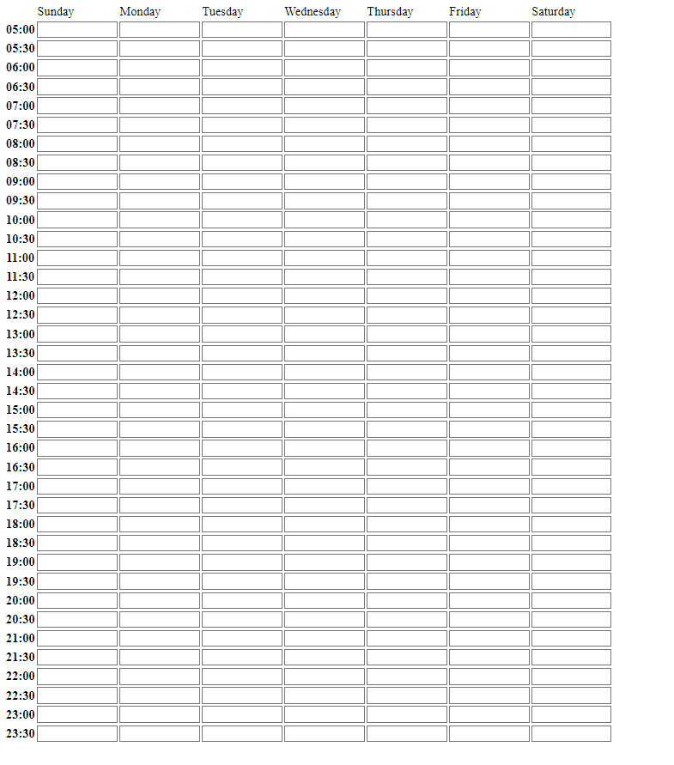
Schedule screen – operating place

